Slide 1
Lesson 1
Learning Intention
To introduce the power of images

Slide 2
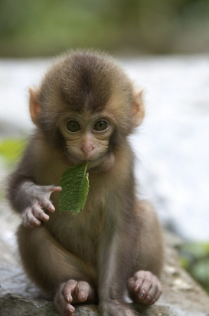
THE POWER OF VISUAL LANGUAGE
Every day the images and texts that surround you influence how you think and feel about issues, power & relationships in society.

Slide 3
Visual Images
Images can be very powerful in positioning people to respond to issues and they are often used to comment on issues that are of concern in society.

Slide 4
Visual Images
Visual language takes many forms:
Graffiti
Political & social cartoons
Posters
Advertisements
News images
Picture books
Graphic novels
Memes
Photographs
…

Slide 5
Visual Images
Following are examples which make a comment about society or position us to respond to issues:
What ideas do you think they are presenting?

Slide 6
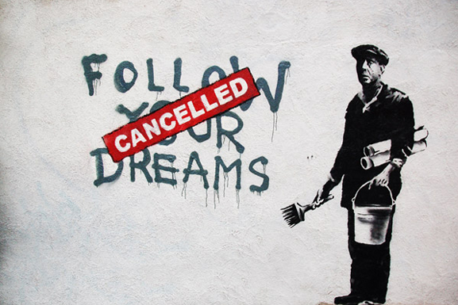

Slide 7
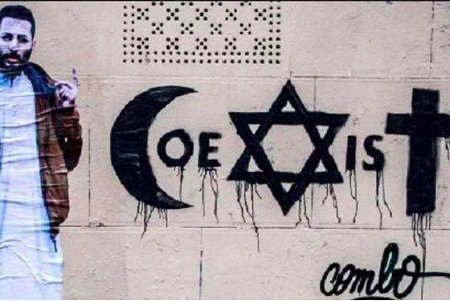
Notes:
From a feature in an online bolog by ‘The Badger’ Tim Perkin
“The coexist society. For all faiths or none” Feb 2016
As a response to the global religious tensions…new society for interfaith dialogue.

Slide 8
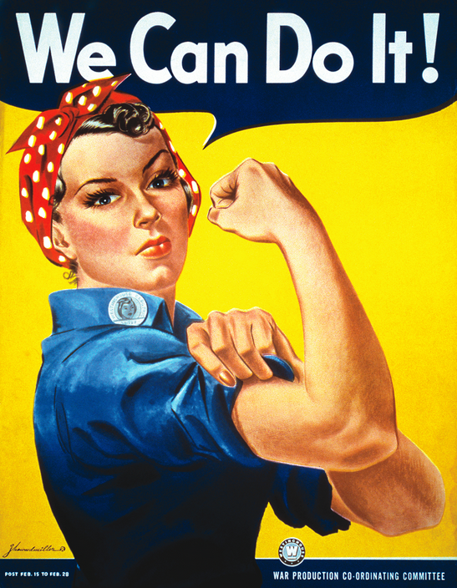

Slide 9
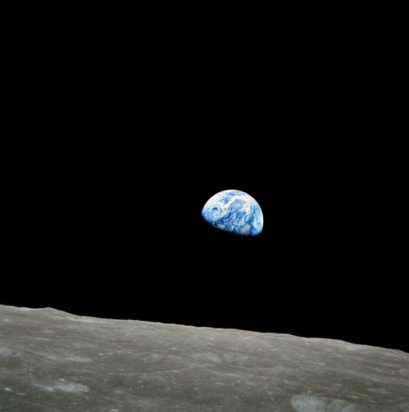
Notes:
Earthrise was taken on the first mission to the moon, Apollo 8. Taken by William Anders in 1968, it was the first time that planet earth had been seen outside of our atmosphere.

Slide 10
WARNING – GRAPHIC CONTENT
Following is an image of children brutalised by war.

Slide 11
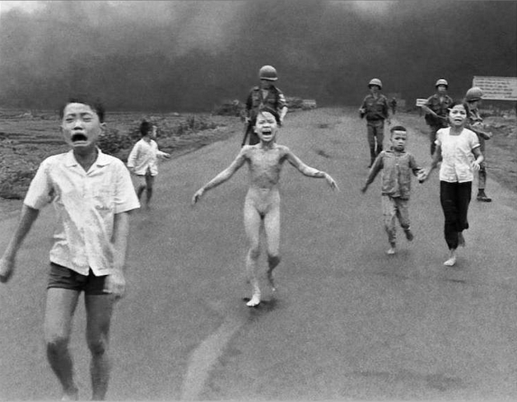
Notes:
This photo by Nick Ut shows Phan Thị Kim Phúc running along a road in Trang Bang after being burned by a South Vietnamese napalm attack is just one of the images that came to symbolise the Vietnam War and resulted in the eventual US withdrawal.

Slide 12
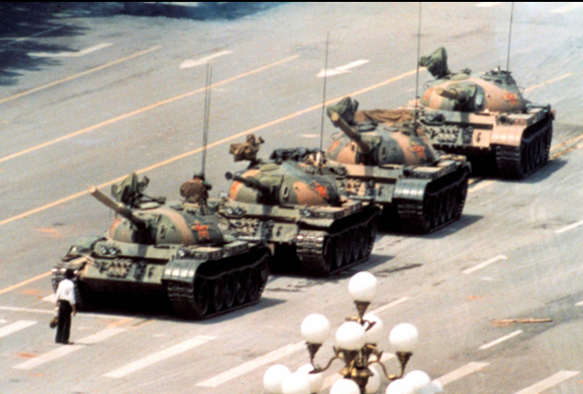

Slide 13
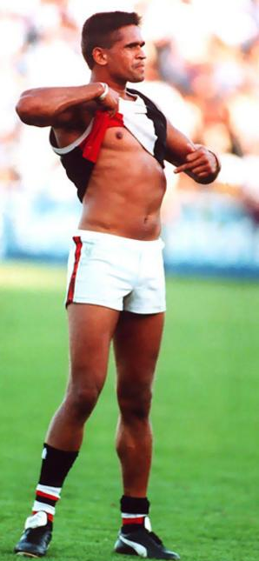

Slide 14
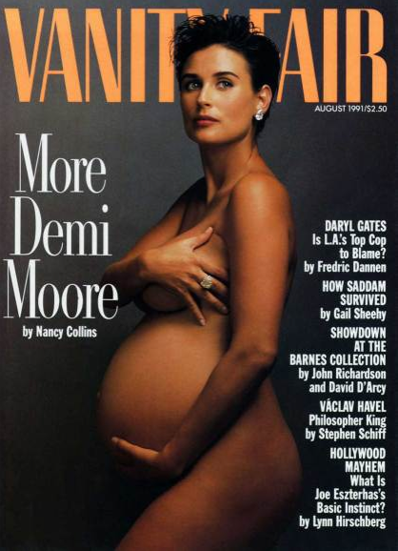
Notes:
Taken by Annie Leibovitz, one of the most influential photographers of our time., this photo set the standards for celeb baby bumps and has been copied a hundred times over - but usually with less visual impact.

Slide 15
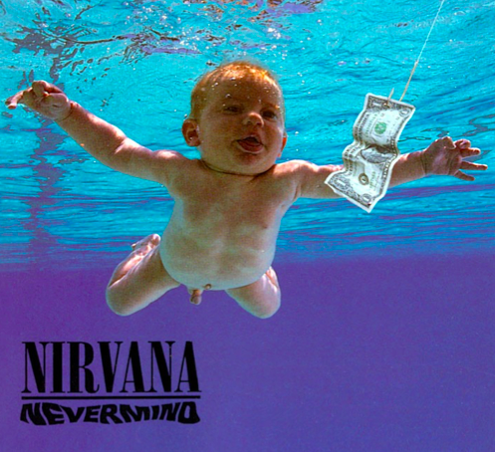

Slide 16


Slide 17
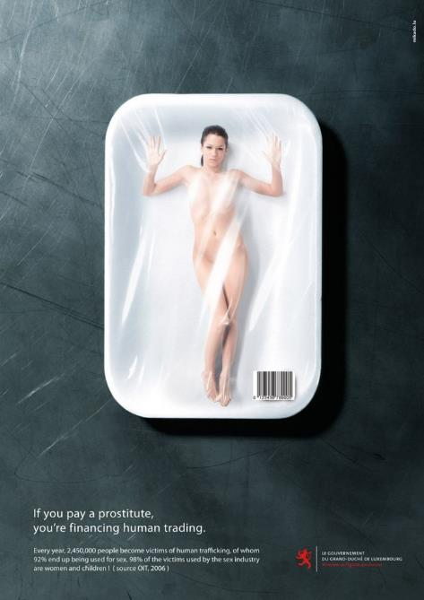

Slide 18
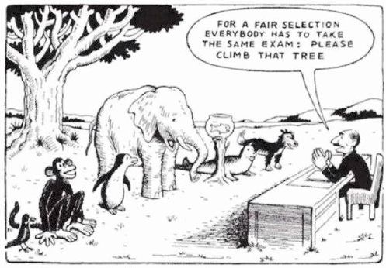

Slide 19
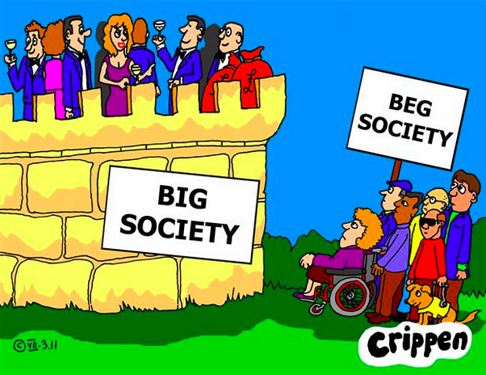
Notes:
Rooted in Rights
Disability Support Page
Cartoon from a feature article
Commentary: “Big Society – Beg Society”

Slide 20
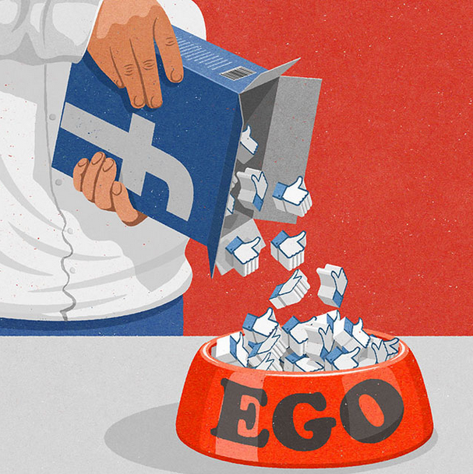
Notes:
Artist John Holcroft
From an online article about him: “Artist Perfectly Captures the Flaws of Our Society In a Series of Witty Illustrations”

Slide 21
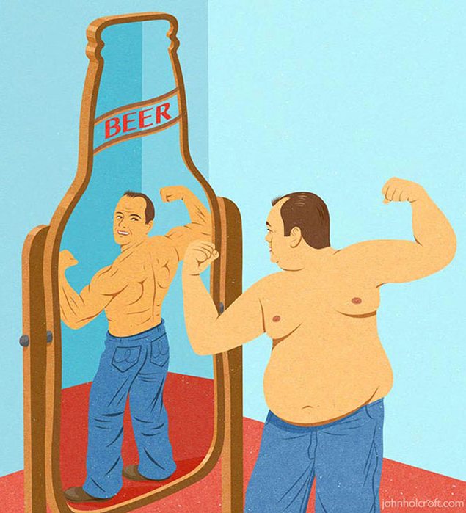
Notes:
Artist John Holcroft
From an online article about him: “Artist Perfectly Captures the Flaws of Our Society In a Series of Witty Illustrations”

Slide 22
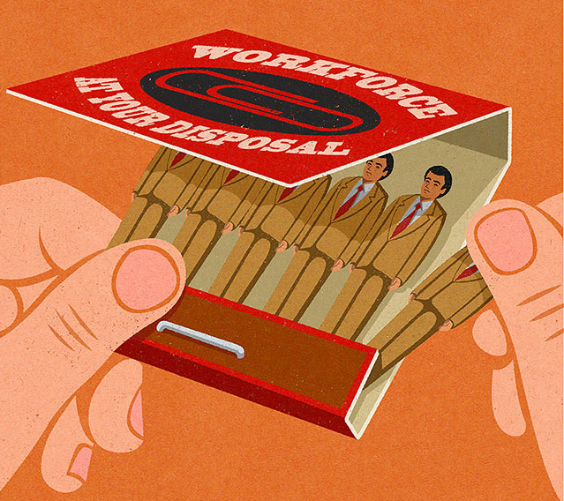
Notes:
Artist John Holcroft
From an online article about him: “Artist Perfectly Captures the Flaws of Our Society In a Series of Witty Illustrations”

Slide 23
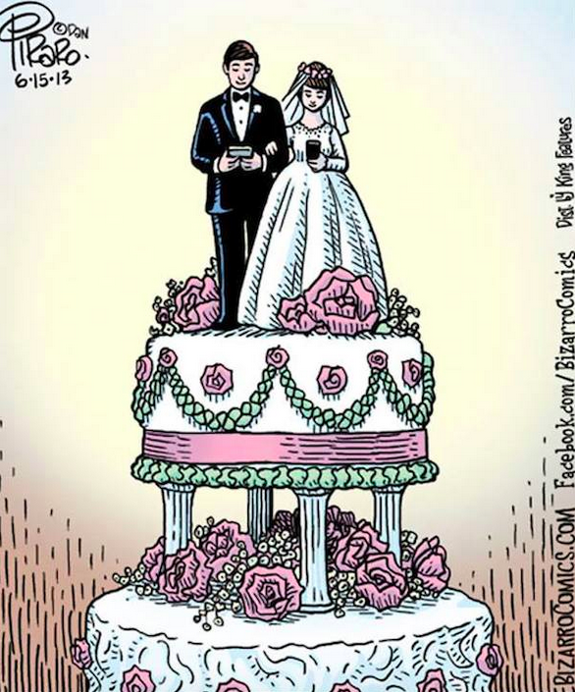
Notes:
Digital Synopsis, Advertising
“How smartphones have taken over our lives” online article

Slide 24
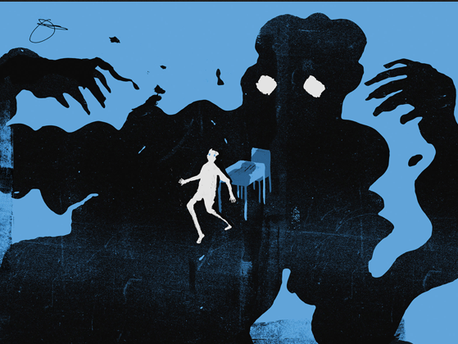
Notes:
Illustration by Daniel Zender for an online article “Abuse of Power” on bullying for ‘Teaching Tolerance’ on online mag

Slide 25


Slide 26
Lesson 2
Learning Intention
To examine the power of images

Slide 27
Visual Images & Power
The following 5 images will be used for the activities about visual images and power:

Slide 28
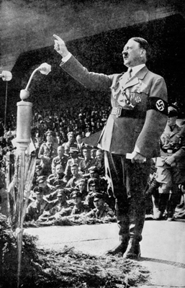
1 Hitler

Slide 29

2 He’s Coming South

Slide 30
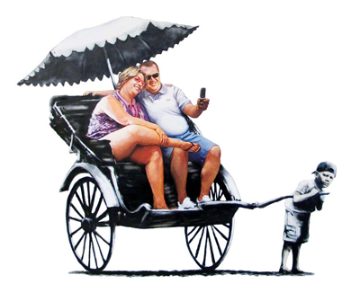
3 Rickshaw 2

Slide 31
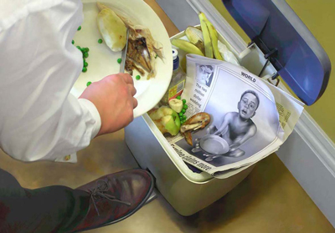
4 Dust

Slide 32
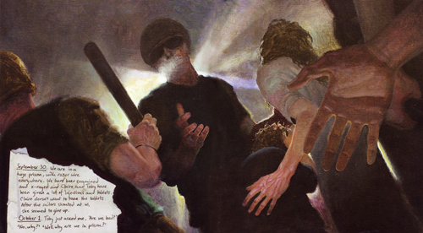
5 Home and Away

Slide 33
Lesson 3
Learning Intention
To examine the importance of context in reading visual communication

Slide 34
Context

Slide 35
1 Hitler
This photograph of Adolf Hitler addressing a Nazi rally was taken in the 1930s. During World War II, Hitler was the chancellor and fuehrer (leader) of the Third Reich in Germany. The Nazi Party, led by Hitler, represented the German national socialists who supported the invasion of neighbouring countries in World War II.

Slide 36
2 He’s Coming South
This image is of a World War II propaganda poster. It was produced in Australia in 1942 and portrays the fear of the Japanese invasion at the time. Propaganda posters were common during this period and they were a deliberate attempt to convince the public to support the war and also to recruit men into the armed forces.

Slide 37
3 Rickshaw 2
This image was created by graffiti artist Banksy. He is well known for commenting on issues in society, particularly on authoritarian groups and freedom rights. This image was part of an exhibition in 2009 at the Bristol Museum and Art Gallery.

Slide 38
4 Dust
This image was created for the picture book Dust, produced in 2007. The book, inspired by the reported starvation of children in Niger in 2005, was produced to raise money for the children's rights organisation Save the Children. This image occurs near the end of the book and the words 'the world has shut its ears and moved on' accompany the image.

Slide 39
5 Home and Away
This image was produced in 2008 in the picture book Home and Away. At the time, the refugee population was increasing and Australians were debating solutions to this controversial population growth.

Slide 40
Lesson 3 Activities
How have your responses to the images changed now that you have the historical context?
Discuss each image
Complete the table on page 4

Slide 42
REPRESENTATION
Lesson 4
Learning Intentions
To identify visual clues that construct representation
Success Criteria
Written Response to two images

Slide 43
REPRESENTATION
The way a subject is constructed and presented by a text

Slide 44
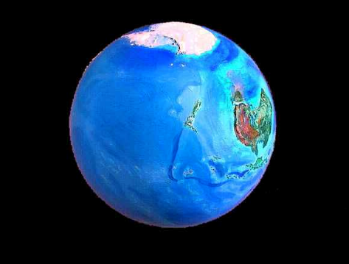
REPRESENTATION
the way a subject is constructed and presented by a text

Slide 45
REPRESENTATION
How does this representation affect thinking about the subject?

Slide 46
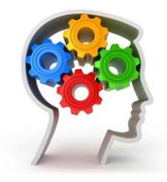
Why is the study of representation important?

Slide 47
Why is the study of representation important?
The way that we think about a subject can be influenced by the way it is presented to us.

Slide 48
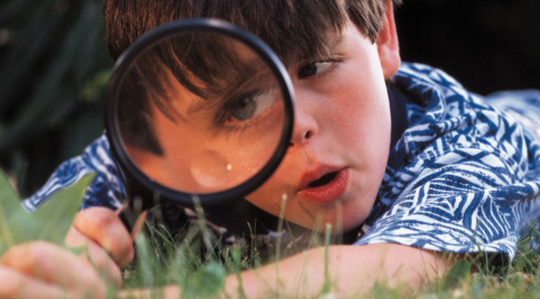
We can study the representation of almost anything:

Slide 49
We can study the representation of almost anything:
How do the following images affect thinking about the subjects?

Slide 50

We can study the representation of almost anything:
Individuals

Slide 51
We can study the representation of almost anything:
Individuals

Slide 52
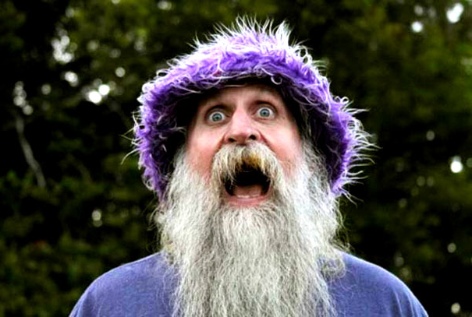
We can study the representation of almost anything:
Individuals

Slide 53

We can study the representation of almost anything:
Groups

Slide 54
We can study the representation of almost anything:
Groups

Slide 55
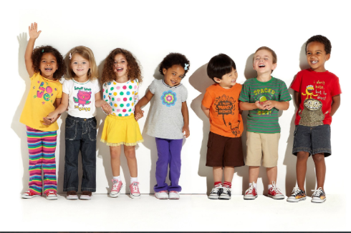
We can study the representation of almost anything:
Groups – eg children

Slide 56
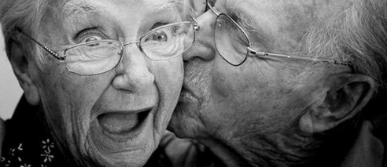
We can study the representation of almost anything:
Groups – eg older people

Slide 57
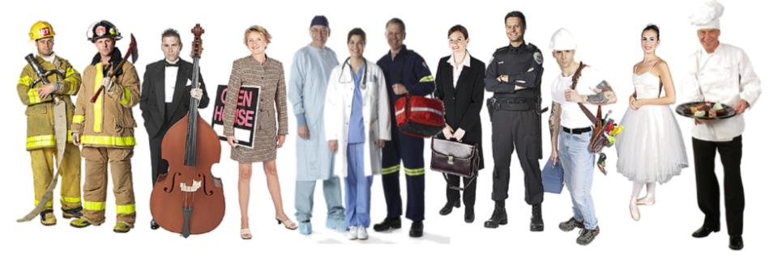
We can study the representation of almost anything:
Groups – eg occupations

Slide 58
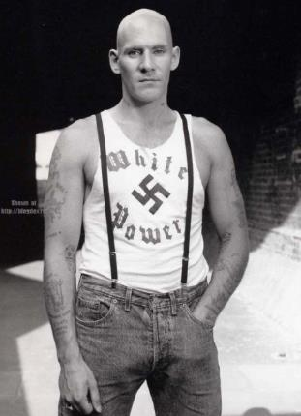
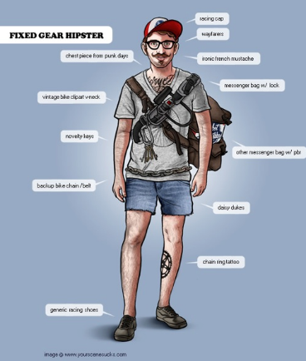
We can study the representation of almost anything:
Groups – eg subcultures

Slide 59
We can study the representation of almost anything:
Groups – eg subcultures

Slide 60
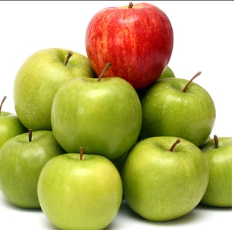
We can study the representation of almost anything:
Organisations

Slide 61
We can study the representation of almost anything:
Organisations

Slide 62
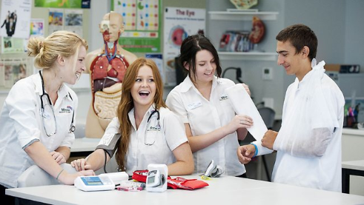
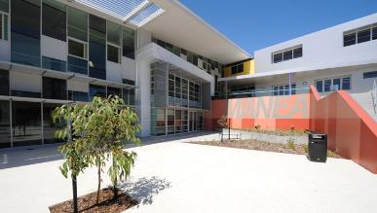
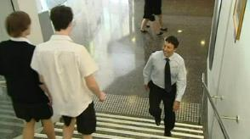
We can study the representation of almost anything:
Organisations – eg schools

Slide 63
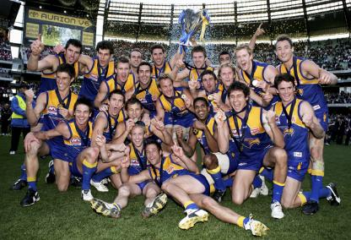
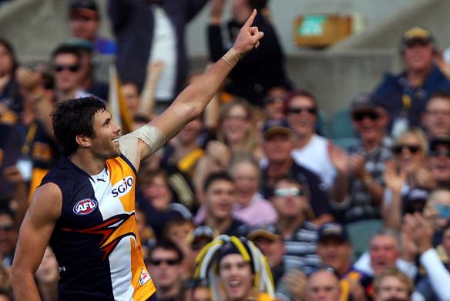

We can study the representation of almost anything:
Organisations – eg sporting clubs

Slide 64

We can study the representation of almost anything:
Abstract concepts

Slide 65
We can study the representation of almost anything:
Abstract concepts

Slide 66
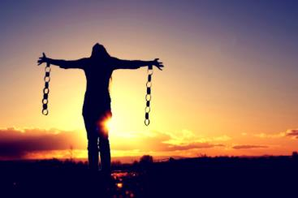
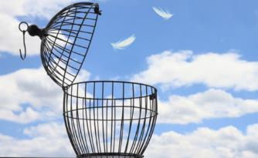
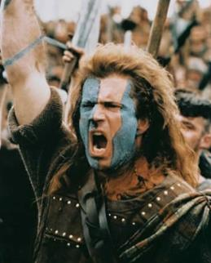

We can study the representation of almost anything:
Abstract concepts - eg freedom

Slide 67
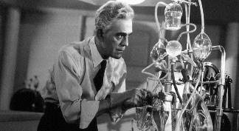
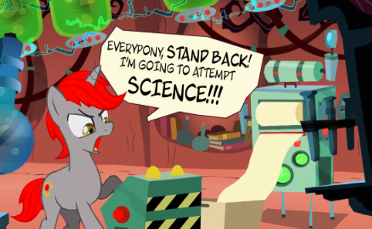

We can study the representation of almost anything:
Abstract concepts - eg science

Slide 68
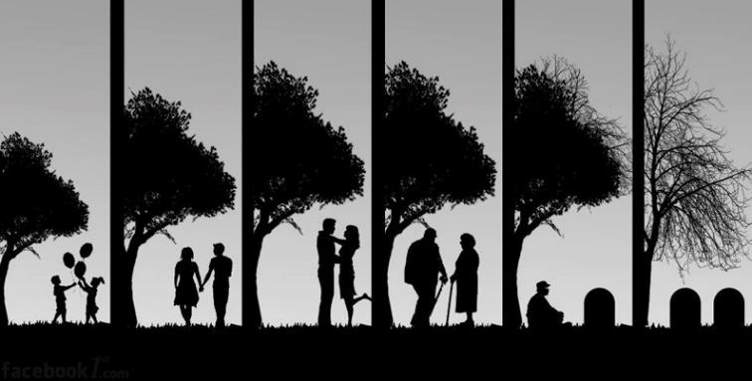
We can study the representation of almost anything:
Aspects of life

Slide 69
We can study the representation of almost anything:
Aspects of life

Slide 70

We can study the representation of almost anything:
Aspects of life – eg Marriage

Slide 71

We can study the representation of almost anything:
Aspects of life – eg Death

Slide 72
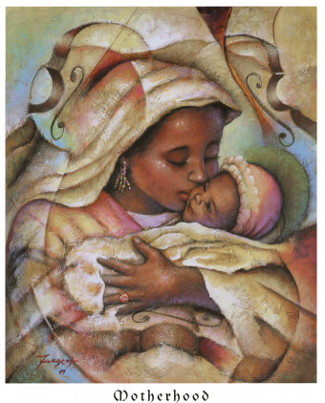
We can study the representation of almost anything:
Aspects of life – eg Motherhood

Slide 73

‘Reading for representation’ means reading critically.
There are many possible ways of thinking about a subject.

Slide 74
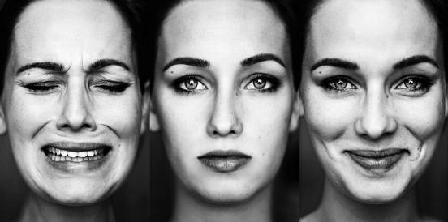
REPRESENTATIONS OF YOU
photographs

Slide 75
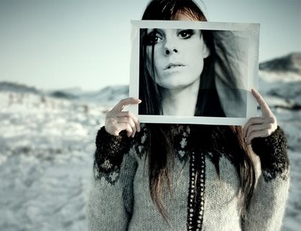
The photograph is not you

Slide 76
The photograph is not you
- it is a representation of you.

Slide 77

Some photos may represent you as happy and friendly.

Slide 78
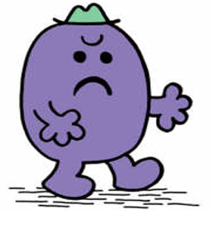
Some as gloomy and unfriendly.

Slide 79

People seeing one set

Slide 80
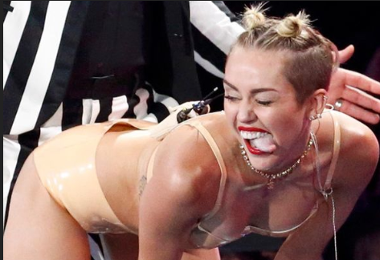
People seeing one set or other

Slide 81
People seeing one set or other will form different impressions of you.

Slide 82
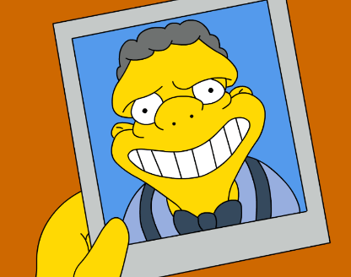
PEOPLE
How do people represent themselves?

Slide 83
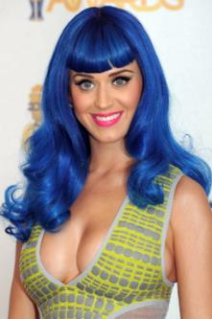


People create an image of themselves through:
Appearance

Slide 84




People create an image of themselves through:
Body language

Slide 85






People create an image of themselves through:
Clothing

Slide 86






People create an image of themselves through:
Speech

Slide 87





People create an image of themselves through:
Behaviour

Slide 88




People create an image of themselves through:
Objects and Places around them

Slide 89

Sometimes people take great care to create an impression.

Slide 90

Other times people may be unaware.

Slide 91



Individuals can be represented by others –
by how they are portrayed and by what is said about them.

Slide 92


People can communicate membership of a group through appearance.

Slide 93
COMPETING & CONFLICTING IDEAS

Slide 94
COMPETING & CONFLICTING IDEAS
Most texts privilege certain ideas and marginalise others.

Slide 95
COMPETING & CONFLICTING IDEAS
Ask about each text:
how much does this representation support or challenge dominant ways of thinking?

Slide 96

Representations of the Elderly
1 an elderly man wearing glasses and an academic gown, holding several large books.
2 a conservatively dressed elderly man standing with arms crossed and an angry expression on his face.
3 a flamboyantly dressed elderly woman, staring into the camera, a strange, puzzled expression on her face.
4 an elderly woman, thin and dressed in pyjamas, sitting up in a hospital bed and being fed by a nurse.
5 an elderly woman, sitting in a rocking chair, reading to a small child whom she cuddles on her lap.

Slide 98
Codes and Conventions
Lesson 5
Learning Intentions
To revise codes and conventions of image analysis
To study a model analysis
To find an image for analysis
Success Criteria
Re-examined codes and conventions
Looked at a model analysis
Found an image for analysis

Slide 99
Actions
Feature Article
Read comments
Respond to five questions in page 2
Study period work
Submit “Representation in Texts”
Visual Images
Revise Codes and Conventions
2x teacher led
1x group

Slide 100


CODES & CONVENTIONS
Examine the images below.
How do these images make you feel about the characters portrayed?
Why do you think they make you feel this way?

Slide 101
CODES & CONVENTIONS
Composition
A hand is included putting something down. Shows he is begging, his place in society
Facial Expression
He is gazing into the distance and downward, with a blank expression.
Camera Angles
The almost eye level shot brings us to the man’s ‘level’. The long shot makes him look alone.
Clothing
Puffy parka, gloves and blanket, hood, looks rugged up against the cold. Utilitarian, doesn’t look disgusting but obviously doing it hard.
Body language
Shoulders down, hunched up, sitting on the ground below everyone else, leaning against a hard wall, passive, staring
But clean and chin up.
Positioning
The man is positioned at a distance with an expanse of hard concrete in front of him in a harsh city setting.
Colour
Greys, dark colours, flesh colours. Small contrasts in the backgorund.

Slide 102
CODES & CONVENTIONS
Camera
Eye leve, full shot. Subject ¾ turned to camera. Suggests importance
Facial Expression
He is looking into the distance with a thoughtful, serious gaze.
Slightly raised chin, classic look of a man in charge
Clothing
Classy blue suit, shirt and tie. Polished shoes. Corporate, business clothes.
He is different and more important than the others in the image. He is not really a worker.
Positioning of man in foreground and dominating the middle third of the photo suggests he is most important. He is in front and at a distance of workers in a work environment suggesting he is a boss.
Colour
Blue suit;; colour of conservative males.
Makes the man stand out against the background.
Body language
Upright, shoulders back, one hand in pocket, legs apart, confident.

Slide 103


Slide 104


Slide 105


Slide 106
Lesson 6
Learning Intentions
To annotate an image
Success Criteria
Image chosen
Image annotated
Retrieval Chart completed

Slide 107
Activities
Choose an image from those offered
Paste into handout on page 25
Annotate
Angle, framing, composition, clothing, colour
Complete the retrieval chart on page 26

Slide 108
Lesson 7
Learning Intentions
To annotate an image
Success Criteria
Image chosen
Image annotated
Retrieval Chart completed
Intro and one technique of response completed

Slide 109
Lesson 8
Learning Intentions
To complete an analysis of an image
Success Criteria
Image annotated
Retrieval Chart completed
Intro and four techniques discussed

